Slide 1
Game Analytics: Behavior Patterns in Player Engagement and Progression
Analysing gameplay data to uncover engagement, progression and purchase patterns.
Presented by
Ayush Chaudhary
Project For
A Leading Online Game Platform

Slide 2
Business Context
The client is a prominent online gaming platform aiming to better understand player demographics, gameplay behavior, and in-game activity across multiple genres and difficulty levels.
This project transforms raw player interaction data including session frequency, playtime, progression, and purchase behavior into actionable insights.
The goal is to support business strategies in player engagement, content balancing and personalized experience design through data-driven decision making.

Slide 3
Problem Statement
Player segments need to be clearly defined to support targeted engagement strategies.
High-value users require identification to prioritize retention efforts.
Behavioral signals linked to churn must be modeled to enable early intervention.
Unlocking deeper insights will help personalize gameplay and improve user satisfaction.
To address these challenges, we leveraged a structured analytics workflow using the following tools.

Slide 4
Technology Stack
Tool/Platform | Purpose in Workflow
Python | Clustering and correlation
SSMS | Querying, storing and accessing structured data
SQL | Data cleaning, transformation and analysis
Excel | EDA visuals and quick validation
Power BI | Dashboard creation and interactive visualization
PowerPoint | Presenting insights to stakeholders

Slide 5
Data Dictionary(1/3)
Columns | Data Type | Description
PlayerID | int | Unique identifier assigned to each players
Age | int | Age of the player in years
Gender | varchar | Gender identity of the player
Location | varchar | Geographic region of the player
GameGenre | varchar | Genre of game played by the user

Slide 6
Data Dictionary(2/3)
Columns | Data Type | Description
PlayTimeHours | float | Total hours played by the user in a week
InGamePurchases | bit | Indicates whether the player has made any in game purchases
GameDifficulty | varchar | Difficulty level
SessionsPerWeek | int | Number of gameplay sessions initiated per week
AvgSessionDurationMinutes | int | Average duration of each gameplay sessions, measured in minutes

Slide 7
Data Dictionary(3/3)
Columns | Data Type | Description
PlayerLevel | int | Current level attained by the player within the game progression system
AchievemnetsUnlocked | int | Total number of distinct achievements earned by the player
EngagementLevel | varchar | Categorical indication of player engagement level

Slide 8
Meta Data(1/2)
We have total 40034 distinct records of players.
Age ranges from 15 to 49 years.
Two Genders male and females
Total 4 locations, which are Asia, USA, Europe and Others.
There are total 5 Game’s genre, which are Sports, Action, Strategy, Simulation and RPG.
InGamePurchases is a Boolean column with 1 represent purchased and 0 means not purchased.
Difficulty of Game is categoried in 3 types, which are Easy, Medium, Hard.
Sessions Count Per Week ranges from 0 to 19.
And Average Session Duration is ranges from as low as 10 minutes to as high as 3 hours.

Slide 9
Meta Data(2/2)
Levels are ranged from 1 to 99.
Count of Achievements rewarded to player is ranging from 0 to 49.
Engagement Level is of 3 types, which are Low, Medium and High.

Slide 10

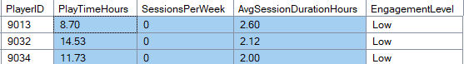
Inconsistencies & Discrepancies in Data
The datatype of PlayerID is int which is prone to change.
There are few records with SessionsPerWeek as zero but PlayTimeHours is nonzero.

Slide 11
Data Cleaning & Fixes Applied
Change the data type of PlayerID from int to varchar.
Update PlayTimeHours and set it to zero where SessionsPerWeek is zero.

Slide 12
Assumptions
PlayTimeHours is assumed to be a total play time of player in week.
AvgSessionDurationMinutes is assumed to be a player’s life time playing average and this value is calculated in minutes.
In Location, Others is assumed all the other locations of players besides Asia, Europe, USA.

Slide 13
Possible Analysis
Analysis | What can be done…
Descriptive | Summarize Player Demographics, average playtime, session frequency, and purchase behavior
Diagnostic | Identify the reasons for low engagement and in- game purchase.
Prescriptive | Recommend personalized games with prescriptive difficulty to boost engagement and purchases.

Slide 14
KPI’s
KPI’s | Caculations | Description
TotalPlayers | Distinct PlayerID count | Total Distinct Players
TotalPlayTimeHours | Sum(PlayTimeHours) | For tracking overall engagement
WeeklyAvgPlayTime | Avg(WeeklyAvgPlayTime) | For tracking weekly engagement
AvgLifeLongPlayTime | Avg(AvgSessionDurationMinutes) | For tracking overall Trend

Slide 15
KPI’s
KPI’s | Caculations | Description
TotalClusters | Count(Distinct Cluster_Label) | Total Players Segment for better strategies
Average of Age | Avg(Age) | Gives an idea about our majority user’s Age
Average of Trend Percent | Avg(TrendPercent) | Helps to predict overall change in Trend
Average of SessionPerWeek | Avg(SessionPerWeek) | Helps to predict overall engagement

Slide 16
KPI’s
KPI’s | Caculations | Description
InGamePurchases | Sum(InGamePurchases) | Target potential user for Revenue
Average of PlayerLevel | Avg(PlayerLevel) | Helps to predict player’s progress in game
Avg Achievements Unlocked | Avg(AchievementsUnlocked) | Helps to predict player’s progress in game

Slide 17
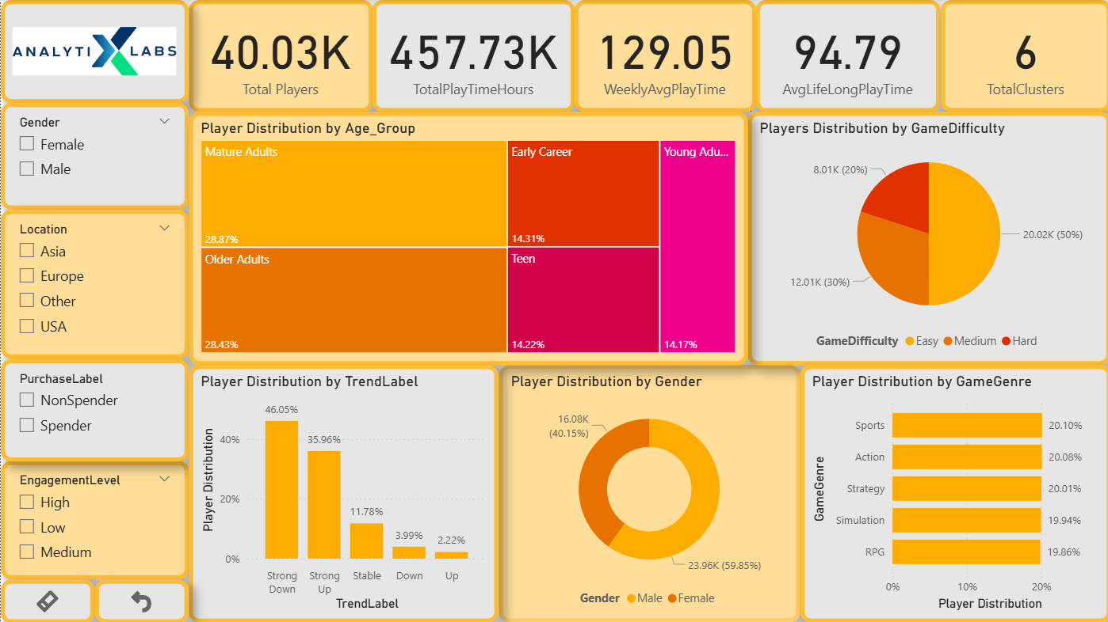
Player Level Dashboard(1/2)

Slide 18
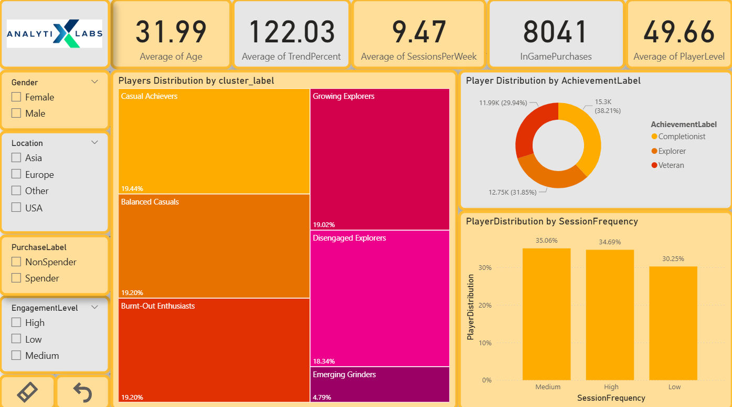
Player Level Dashboard (2/2)

Slide 19
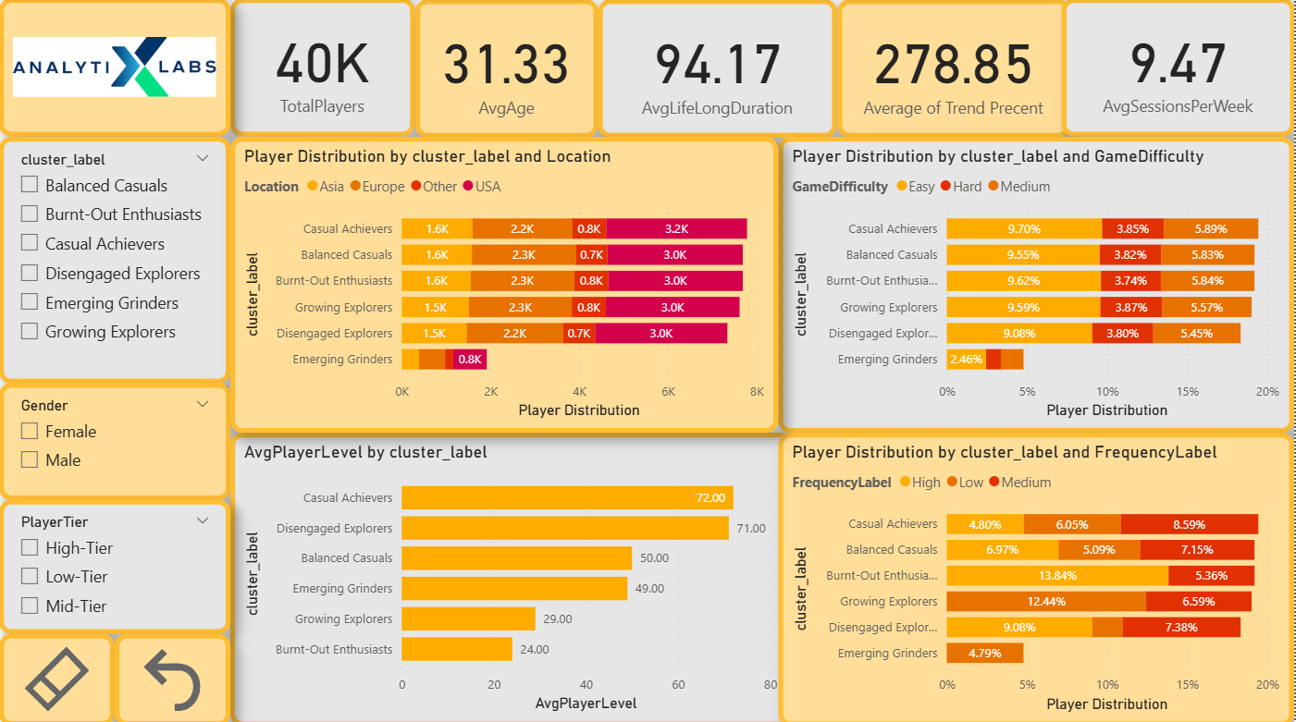
Cluster Level Dashboard(1/2)

Slide 20
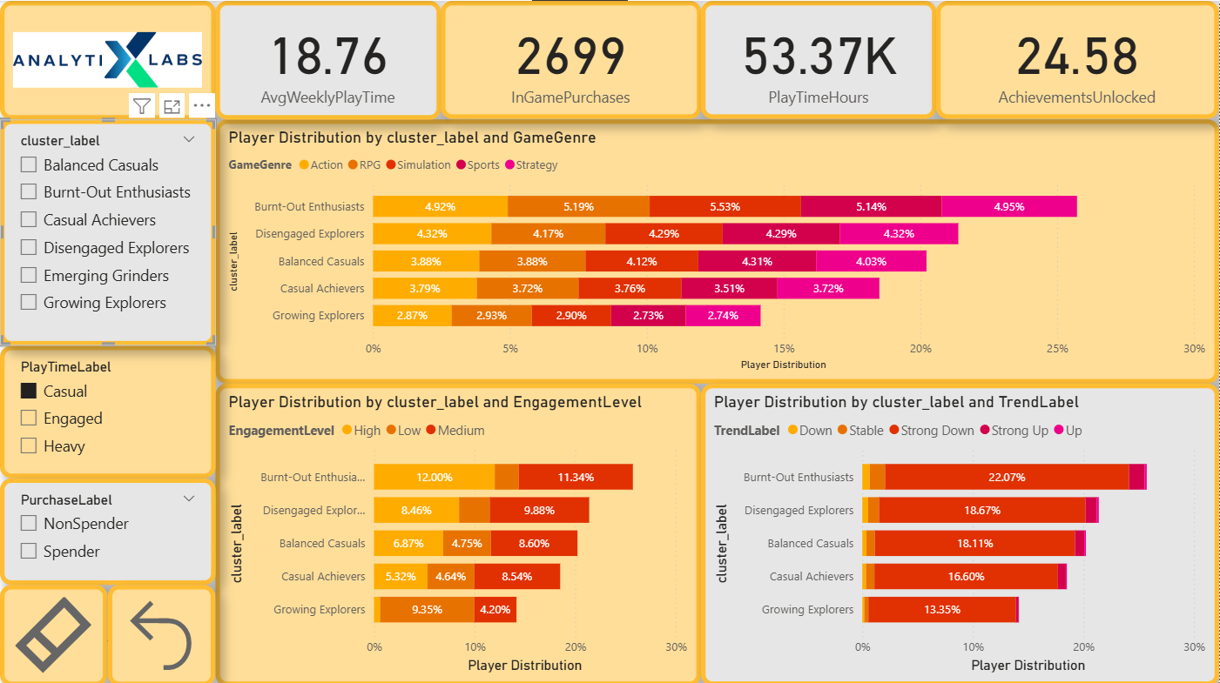
Cluster Level Dashboard(1/2)

Slide 21
Stakeholder & Recommendations
Marketing Team, Strategist, High Level Managements(Stakeholders).
Diversify Platform with Different game having multiple Play Modes to target wide range of player with different skill sets.
Create a community and page to showcase best in game moments and provide place to discuss strategies and other things among players of different servers.
Host multiple small and big tournaments with real prize money and game resources as prize pool to encourage players to spend money on in game purchases to equip themselves and compete.

Slide 22
KPI’s

Slide 23
KPI’s

Slide 24
KPI’s

Slide 25
EDA

Slide 26
Player’s Distribution by Gender Player’s Distribution by Location
60% of Players are Male.
40% of Players are from Europe
Increase the games centric for Females like puzzles etc.
Incorporate regional games to increase engagement from different locations.

Slide 27
Player’s Distribution by Game Genre Player’s Distribution by Game Difficulty
Player Usually prefer Easy games which is 50%
Hold mini events to encourage engagements in other games too.
Incorporate multiple modes like Normal, Veteran, Hell modes in games.

Slide 28
Player’s Distribution by Age Group Player’s Distribution by Trend
46% of total players showing strong downward trend.
36% shows Strong Upward Trend.
Possible reason for down trend may be the less diversity in games, not a good personalize recommendations

Slide 29
Player’s Distribution by Spender and Non-Spender
Only 20% of total players done In-Game Purchases.
Hold tournaments with real prize money and provide personalized discounts on game resources to encourage player to equip themselves better to compete in tournaments.

Slide 30
Gender wise Average Play Time Distribution Location wise Average Play Time
Male plays around 8min longer than female.
Player from Asia plays more than any other location.
Increase the engagement of female.
Understand the demographics of players and diversify platform with local centric games.

Slide 31
Avg Play Time w.r.t Game Genre Avg Play Time w.r.t Game Difficulty
Players usually spent more time playing Action and Strategy games which are Hard.
Diversify Platform with challenging and strategic games with multiple modes to target most of the players.
Hold Tournament with Real Prize money.

Slide 32
Avg Play Time w.r.t Age Groups Avg Play Time Per Trend
Users which are in Early Career tends to play more games and they can spare extra money to increase their gaming experiences.
Average Playtime of Down Trend players are 40% less
Target Early Career individuals for revenue generation and try to create better user experience for them.
Diversify and improve personalization strategies to stop the leakage of churned players.

Slide 33
Avg Play Time w.r.t Spender and Non-Spender
Spenders Play Time is lower than Non-Spenders, which means that they loses their interest in games after buying game resources.
Diversify games which are challenging even after using in game resources.
Hold Tournament with real prize money.

Slide 34
Avg Weekly Play Sessions w.r.t Gender Avg Play Sessions w.r.t location
Females from Asia has comparatively higher sessions per week.
Diversify the platform with games which has shorter playtime, like multiplayer games with 5mins countdowns so, that players can play in between there daily breaks to increase their sessions per week
Hold mini weekly tournaments.

Slide 35
Avg Play Session w.r.t Game Genre Avg Play Session w.r.t Game Difficulty
Sports and Strategy games with medium and hard difficulty has more Sessions per week.
Break games in multiple levels with shorter play time so increase weekly engagement of players
Initiate mini weekly tournaments.

Slide 36
Avg Play Session w.r.t Age Groups Avg Play Session Per Trend

Slide 37
Avg Play Session w.r.t Spender and Non-Spender
Spenders has comparatively more weekly sessions
Provide discount deals on game resources and create forums to show off their skills and mini clips of there best moments in games

Slide 38
Player’s Average Level w.r.t Gender Player Level w.r.t Location
Levels of Male from other locations are comparatively higher.
Hold All Tier Tournament with higher prize money with higher Tier to encourage players to level up more and thus increases their engagement with platform.

Slide 39
Player Level w.r.t Game Genre Player Level w.r.t Game Difficulty
Simulation game with easy difficulty has lowest level, which may be due to players lost interest after not finding it as challenging compare to other genre and difficult games.
Diversify the platform with games which are all player friendly with multiple modes like normal, veteran and hell modes.

Slide 40
Avg Player Level w.r.t Age Groups Avg Player Level per Trend
Teens Average level is lowest which may be due to there engagement with outdoor games more.
Average Level of Stable Players are low as may be their engagement with platform is limited.
Create a page for players and their best game moments to attract Teens traffic and hold tournament to compete and win exciting prizes.

Slide 41
Avg Player Level w.r.t Spender and Non-Spender
Non-Spenders levels are lower.
Create Page to showcase the best moments and achievements to encourage players to spend on in Game purchase.
Hold Tournaments with game resources and money as prize.

Slide 42
Average Achievements Unlocked w.r.t Gender Average Achievements Unlocked w.r.t Location
Male from Asia Bagged more Achievements compared to others.
Unlocking Achievements increase game awareness which in turn increase engagements.
Give new stylish titles and tag names like Hell Hunter, Lord of Era something like this to encourage exploration and engagement of players

Slide 43
Average Achievements Unlocked w.r.t Game Genre Average Achievements Unlocked w.r.t Game Difficulty
Sports genre with hard difficulty is explored least.
Create Game Page and show best in game moments which encourage players to explore and unlock new moves and achievements which further increases their engagement with platform

Slide 44
Average Achievements Unlocked w.r.t Age Groups Average Achievements Unlocked Per Trend
Early Career Segment has least Achievements Bagged, which may be due to there less interest in exploring games.
Stable Users are least when compared with others which may be due to there limited and balanced play trend.
Create Game Page and show best in game moments to encourage players to explore new moves and fancy Tag Lines.
Create a community to share the finding of games among players from all different servers.

Slide 45
Average Achievements Unlocked w.r.t Spender and Non-Spender
Both Spender and Non-Spender Bagged Same number of Achievements.

Slide 46
Clusters
Casual Achievers : Medium engagement, like easier games, don’t spend money, but grind achievements.
Burnt-Out Enthusiasts : High engagement & frequency but trend is falling -> likely at risk of churn.
Disengaged Explorers : Once active, now disengaging. Explore but don’t buy.
Emerging Grinders : Currently heavy playtime but low engagement history -> they’re on the rise, potentially new committed players.
Balanced Casuals : Middle-of-the –road in most traits. Neither high risk nor high value.
Growing Explorers : Medium engagement, increasing trend, heavy but inconsistent play -> still finding their rhythm.

Slide 47
Players Per Clusters
Emerging Grinders count is least, which we can increase with targeted promotions on social media platforms where people usually spent their free time.
We can also create a community and page for showcasing best in game moments to attract more traffic.
We can also sell the game merchandises to attract Teens.

Slide 48
Average Life Long Play Time Per Clusters
Growing Explorers has highest average play time which can be exploit to potentially convert them into spenders by giving personalized discount on game resources.
Hold tournaments with real prize money and game resources to convert deisengaged Explorers to burnt-out enthuisiasts.

Slide 49
Average Age per Cluster
Emerging Grinders and Burnt-Out Enthusiasts are consisting of younger population.
We can do target promotions and mini weekly tournaments to increase the engagement of youth and decrease the average age per clusters while building strong young fan base.

Slide 50
Average Player Level Per Cluster
Burnt-Out Enthusiasts Average level is quite low even while they invest lots of time per session, this may later create disinterest among them.
Diversify platform with games which are challenging as well as easy to progress at initial stage which will hook player, games should also have different modes like normal , veteran, hell modes for players with different skill sets.

Slide 51
Average Weekly Play Time per Cluster
Emerging Grinders average weekly play time is 18hrs which is super high when compared to others.
We can use this to promote personalize advertisement; we can even encourage and convert them to in-game purchaser.
Holding Weekly mini events and tournaments will greatly helps to increase the engagement levels.

Slide 52
Achievements Bagged Per Clusters
Disengaged Explorers Achievements are quite low, which may indicate that they are losing interest in games.
Enhance Personalize recommendation strategies for better platform experience.
Diversify platforms with games which has multiple playing modes for every type of players with different skill sets.
Create community and page for players to encourage engagement among different server's players.

Slide 53
Average Weekly Sessions Per Clusters
Sessions per week for Emerging Grinders are quite low, which may be cause the risk of losing them.
Diversify Games with Shorter play time, like some shooting games with 5 min countdown , create catchy achievement tag line which a player can wear with its name , this may encourage them to explore and focus on Achievement unlock which in turn will increase their play time as well as sessions per week.

Slide 54
Spender’s Count Per Clusters
There is zero Spending trends among majority of clusters.
Balanced Casuals are consisting of players who are ready to pay little extra to enhance their playing experience, they are the main source of revenue for platform.
We can host event and tournaments with real prize money and game resource pool; this will encourage players to spend money as investment on game resource which they may later win back from tournaments.

Slide 55
Net Trend per Clusters
Net Trend clearly shows the Average weekly play time vs Average play time.
Burnt-Out Enthusiasts and Disengaged Explorers are losing their interest on long run and are closest to the risk of churning.
Create personalize strategies for players to enhance their personal experience.
Host events, tournaments and create community to make players feel sense of belonging with platform.

Slide 56
Cluster Analysis

Slide 57
K1 Casual Achievers
Casual Achievers consists of 60% Medium Engagement Level.
45% of total Casual Achievers shows strong down trend.
This group consist of 100% Non-In-Game Spenders.
36% of total consist of Heavy Play Time Player.
Frequency of their sessions per week are 45% medium.
This group is consisting of 65% of High Tier and 82% of Completionist Players .

Slide 58
Casual Achievers
Engagement Level of Casual Achievers
Play Time Label Distribution of Casual Achievers

Slide 59
Casual Achievers
Session Frequency of Casual Achievers
Tier Distribution of Casual Achievers

Slide 60
K2 Burnt-Out-Enthusiasts
Burnt-Out-Enthusiasts consists of 45% High Engagement Level.
62% of total Burnt-Out-Enthusiasts shows strong down trend.
This group consist of 100% Non-In-Game Spenders.
48% of total consist of Engaged Play Time Player.
Frequency of their sessions per week are 72% High.
This group is consisting of 70% of Low Tier and 48% of Completionist Players .

Slide 61
Burnt-Out-Enthusiasts
Engagement Level of Burnt-Out Enthusiasts
Play Time Label Distribution of Burnt-Out Enthusiasts

Slide 62
Burnt-Out-Enthusiasts
Session Frequency of Burnt-Out Enthusiasts
Tier Distribution of Burnt-Out Enthusiasts

Slide 63
K3 Disengaged Explorers
Disengaged Explorers consists of 50% Low Engagement Level.
55% of total Disengaged Explorers shows strong down trend.
This group consist of 100% Non-In-Game Spenders.
42% of total consist of Engaged Play time Players.
Frequency of their sessions per week are 50% High.
This group is consisting of 63% of High Tier and 70% of Explorer Players .

Slide 64
Disengaged Explorers
Engagement Level of Disengaged Explorers
Play Time Label of Disengaged Explorers

Slide 65
Disengaged Explorers
Session Frequency of Disengaged Explorers
Tier Distribution of Disengaged Explorers

Slide 66
K4 Emerging Grinders
Emerging Grinders consists of 85% Low Engagement Level.
100% of total Emerging Grinders shows strong up trend.
This group consist of 82% Non-In-Game Spenders.
This group is consisting of 100% Heavy Play time Players.
Frequency of their sessions per week are 100% low.
This group is consisting 38% of Completionist Players .

Slide 67
Emerging Grinders
Engagement Level of Emerging Grinders
Play Time Label of Emerging Grinders

Slide 68
Emerging Grinders
Session Frequency of Emerging Grinders
Tier Distribution of Emerging Grinders

Slide 69
K5 Balanced Casuals
Balanced Casuals consists of 50% Medium Engagement Level.
50% of total Casual Achievers shows strong down trend.
This group consist of 100% In-Game Spenders.
36% of total consisting of Engaged Play Time Players.
Frequency of their sessions per week are 38% medium.
This group is consisting 32% of Completionist Players .

Slide 70
Balanced Casuals
Engagement Level of Balanced Casuals
Play Time Label of Balanced Casuals

Slide 71
Balanced Casuals
Session Frequency of Balanced Casuals
Tier Distribution of Balanced Casuals

Slide 72
K6 Growing Explorers
Growing Explorers consists of 45% Medium Engagement Level.
52% of total Growing Explorers shows strong up trend.
This group consist of 100% Non-In-Game Spenders.
60% of total consisting of Heavy Play Time Players.
Frequency of their sessions per week are 65% low.
This group is consisting of 60% of Low Tier and 42% of Completionist Players .

Slide 73
Growing Explorers
Engagement Level of Growing Explorers
Play Time Label of Growing Explorers

Slide 74
Growing Explorers
Session Frequency of Growing Explorers
Tier Distribution of Growing Explorers

Slide 75
THANK YOU!

